Slide 1


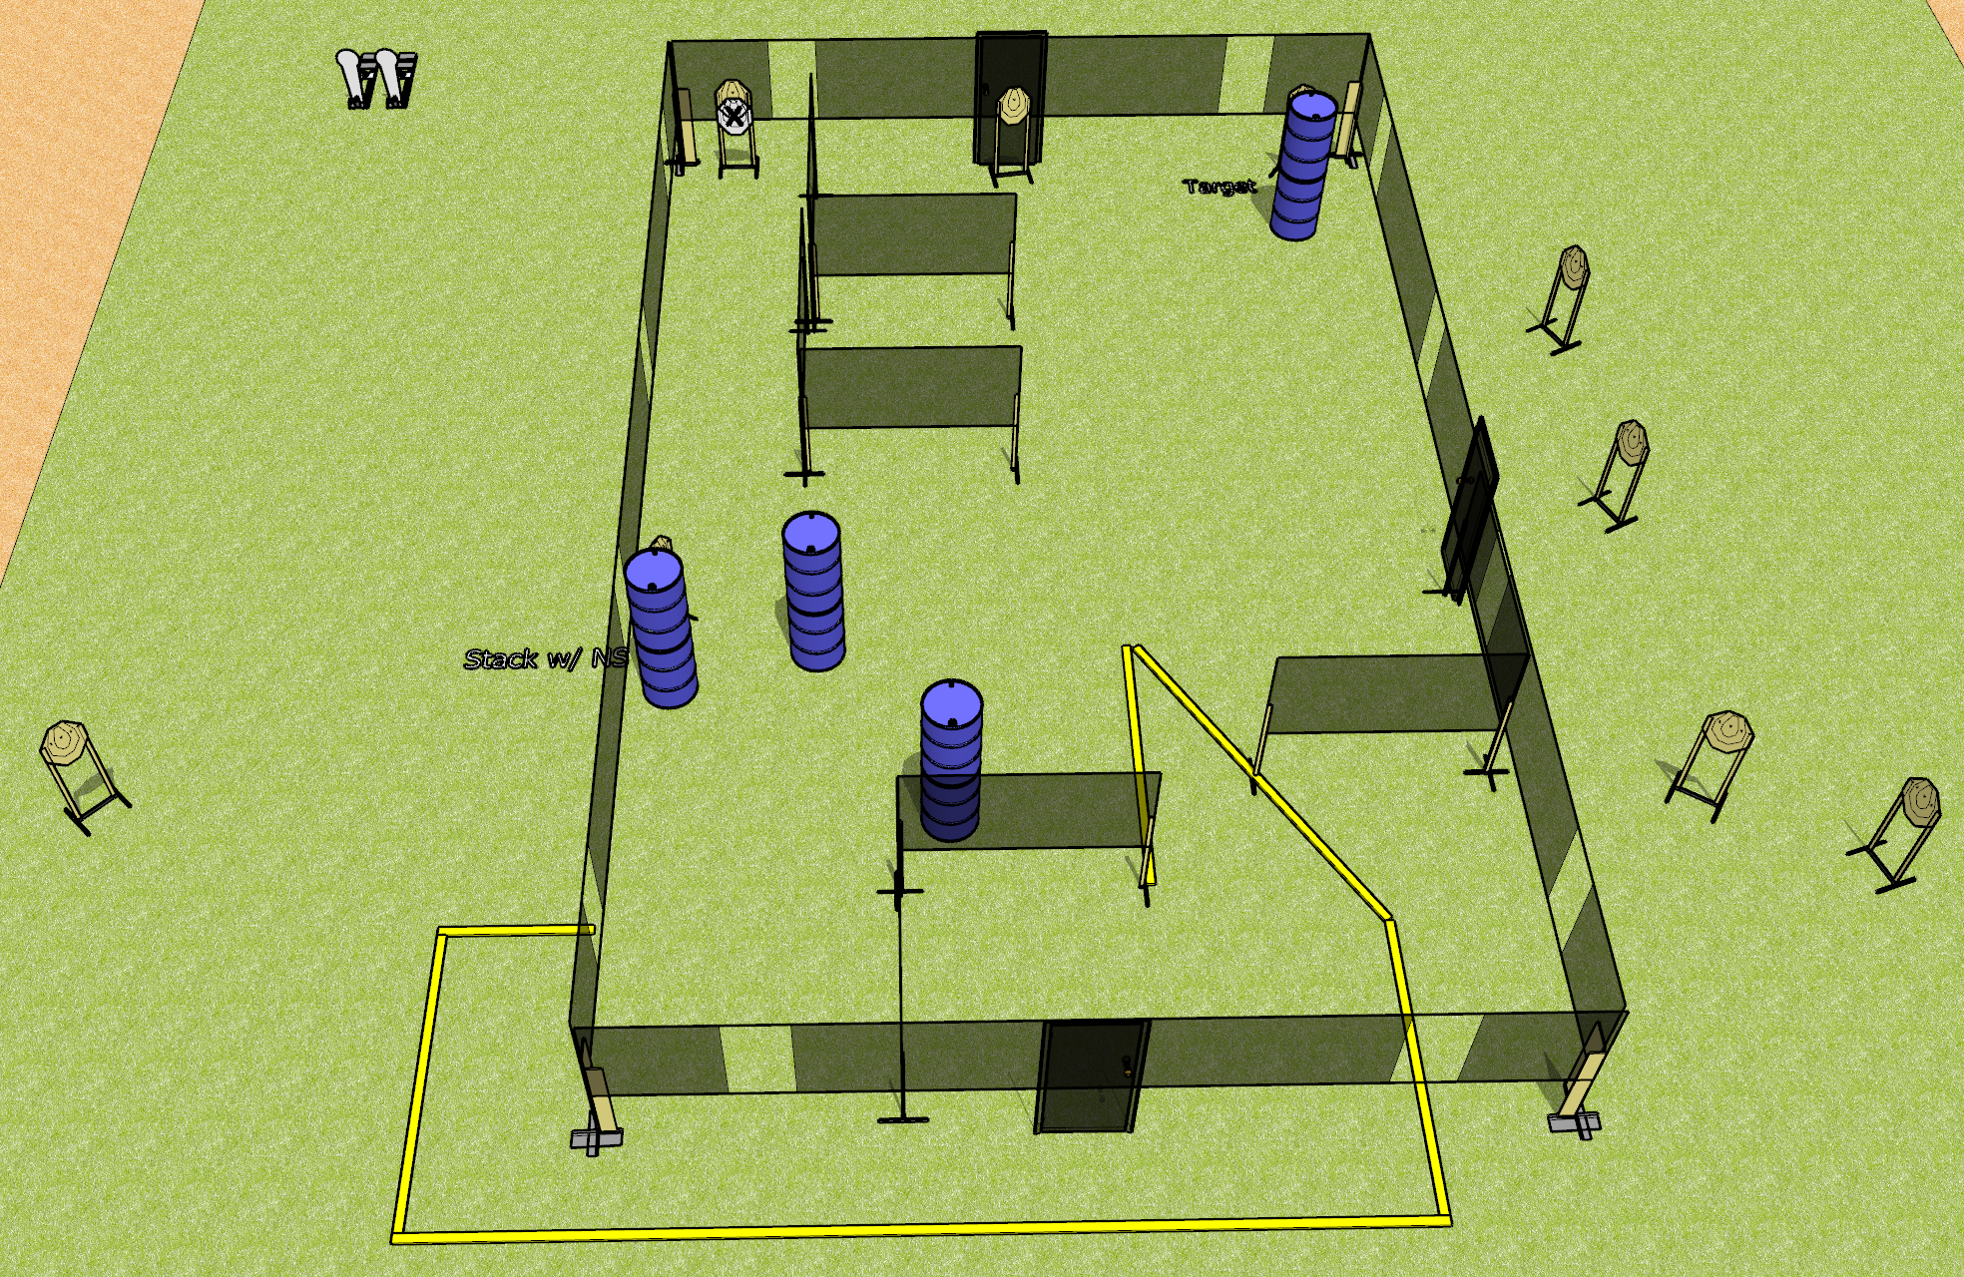
 | Dothan Gun Club – USPSA Match Chuggin Along Course Designer : Drew Coleman
Round Count 22 rounds 10 IPSC 2 colt poppers
Equipment List 1 medium fault line 12 targets (10 + 2 NS)

Slide 2
Chuggin Along
Written Stage Briefing
Chuggin Along is a 22 round, 110 point, Comstock course of fire. There are 10 IPSC targets and 2 steel. The best 2 hits on cardboard will score and steel must fall to score.
Handgun start position is feet on X’s, wrists below belt. Handgun is loaded and holstered.
PCC start position is feet on X’s, stock on belt. Loaded carbine is held with both hands, safety on.
On audible start signal, engage targets as they become available from within the shooting area.

